Slide 1

SOCIAL MEDIA AND MENTAL HEALTH When words are all we have
Anonymous platforms like Reddit reveal raw, unfiltered mental health struggles people won’t say out loud.
Depression and anxiety are among the most prevalent yet underdiagnosed conditions today.
Our goal is to use ML algorithms to classify Reddit posts into categories such as anxiety, depression, and suicide risk.
Benchmark 6 different models from logistic regression to DistilBERT algorithm
BY
ARDHRA ANN DENNY
MANU SHARANYA BHADRIRAJU

Slide 2
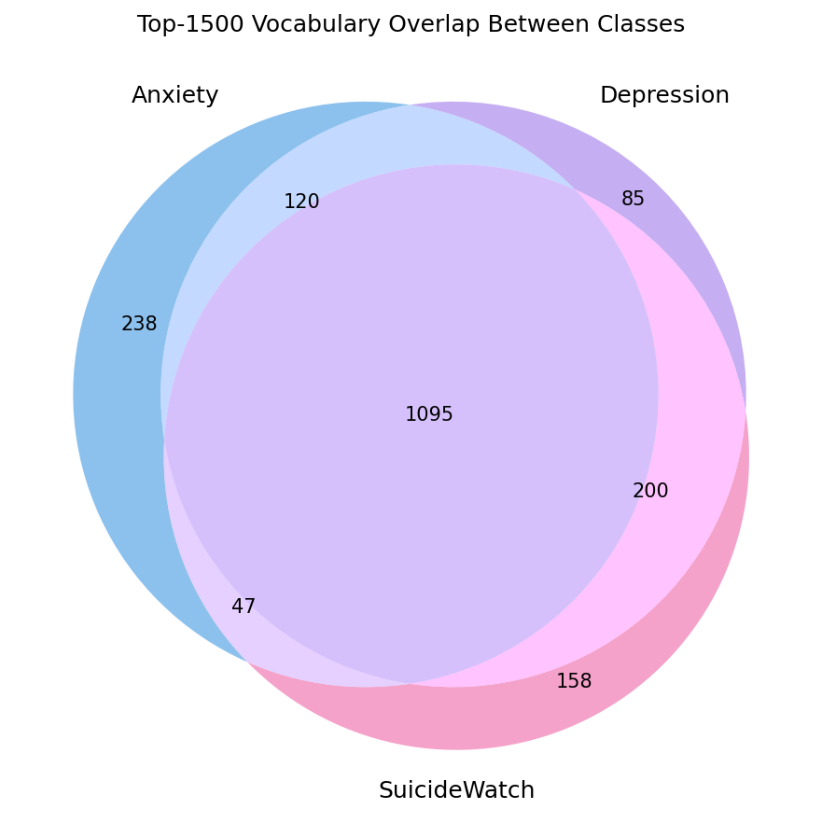
DATASET
Dataset was a Kaggle Reddit Mental Health Dataset
It contains reddit posts of 5 subreddits relating to mental health
We took 12,000 posts spanning 3 subreddits; Depression, Anxiety and SuicideWatch
Each post contains a title, selftext body, taken as features and the subreddit label used as the class target
Problems Faced:
Overlapping of data, especially between the Depression and SuicideWatch labels, tried to handle with limiting the stop words.
Combining the data.

Slide 3
RESULTS
ALGORITHM | ACCURACY | PRECISION | RECALL | F1 SCORE
Logistic Regression | 0.7476 | A: 0.90; D:0.65; S:0.69 | A: 0.86; D:0.67; S:0.71 | A: 0.88; D:0.66; S:0.70
Naïve Bayes | 0.7123 | A: 0.84; D:0.61; S:0.68 | A: 0.85; D:0.61; S:0.67 | A: 0.85; D:0.61; S:0.67
SVM | 0.7327 | A: 0.89; D:0.63; S:0.67 | A: 0.87; D:0.64; S:0.69 | A: 0.88; D:0.64; S:0.68
XG Boost | 0.7403 | A: 0.;91 D:0.64; S:0.68 | A: 0.85; D:0.66; S:0.71 | A: 0.88; D:0.65; S:0.69
MLP | 0.7153 | A: 0.86; D:0.63; S:0.65 | A: 0.86; D:0.59; S:0.69 | A: 0.86; D:0.61; S:0.67
DistilBERT | 0.7675 | A: 0.90; D:0.69; S:0.71 | A: 0.89; D:0.65; S:0.76 | A: 0.90; D:0.67; S:0.74

Slide 4
CONCLUSION AND FUTURE SCOPE
DistilBERT outperformed all models, highlighting the strength of contextual embeddings over bag-of-words.
Anxiety showed the highest per-class F1 (0.90); Depression was the most challenging (0.67) due to semantic overlap with adjacent subreddits.
Future Scope:
Aim to explore domain-specific transformers such as Mental-BERT or RoBERTa for improved performance.
Develop a real-time classification pipeline using the Reddit API for continuous monitoring.
Apply contrastive learning techniques to better separate semantically similar classes

